Slide 1


Module 2. Lesson 6.
Memory Card Application P. 4
Link to the methodological guidelines

Slide 2

Module 2. Lesson 6. Memory Card Application. P. 4
Discussion:
Memory Card Application

Slide 3
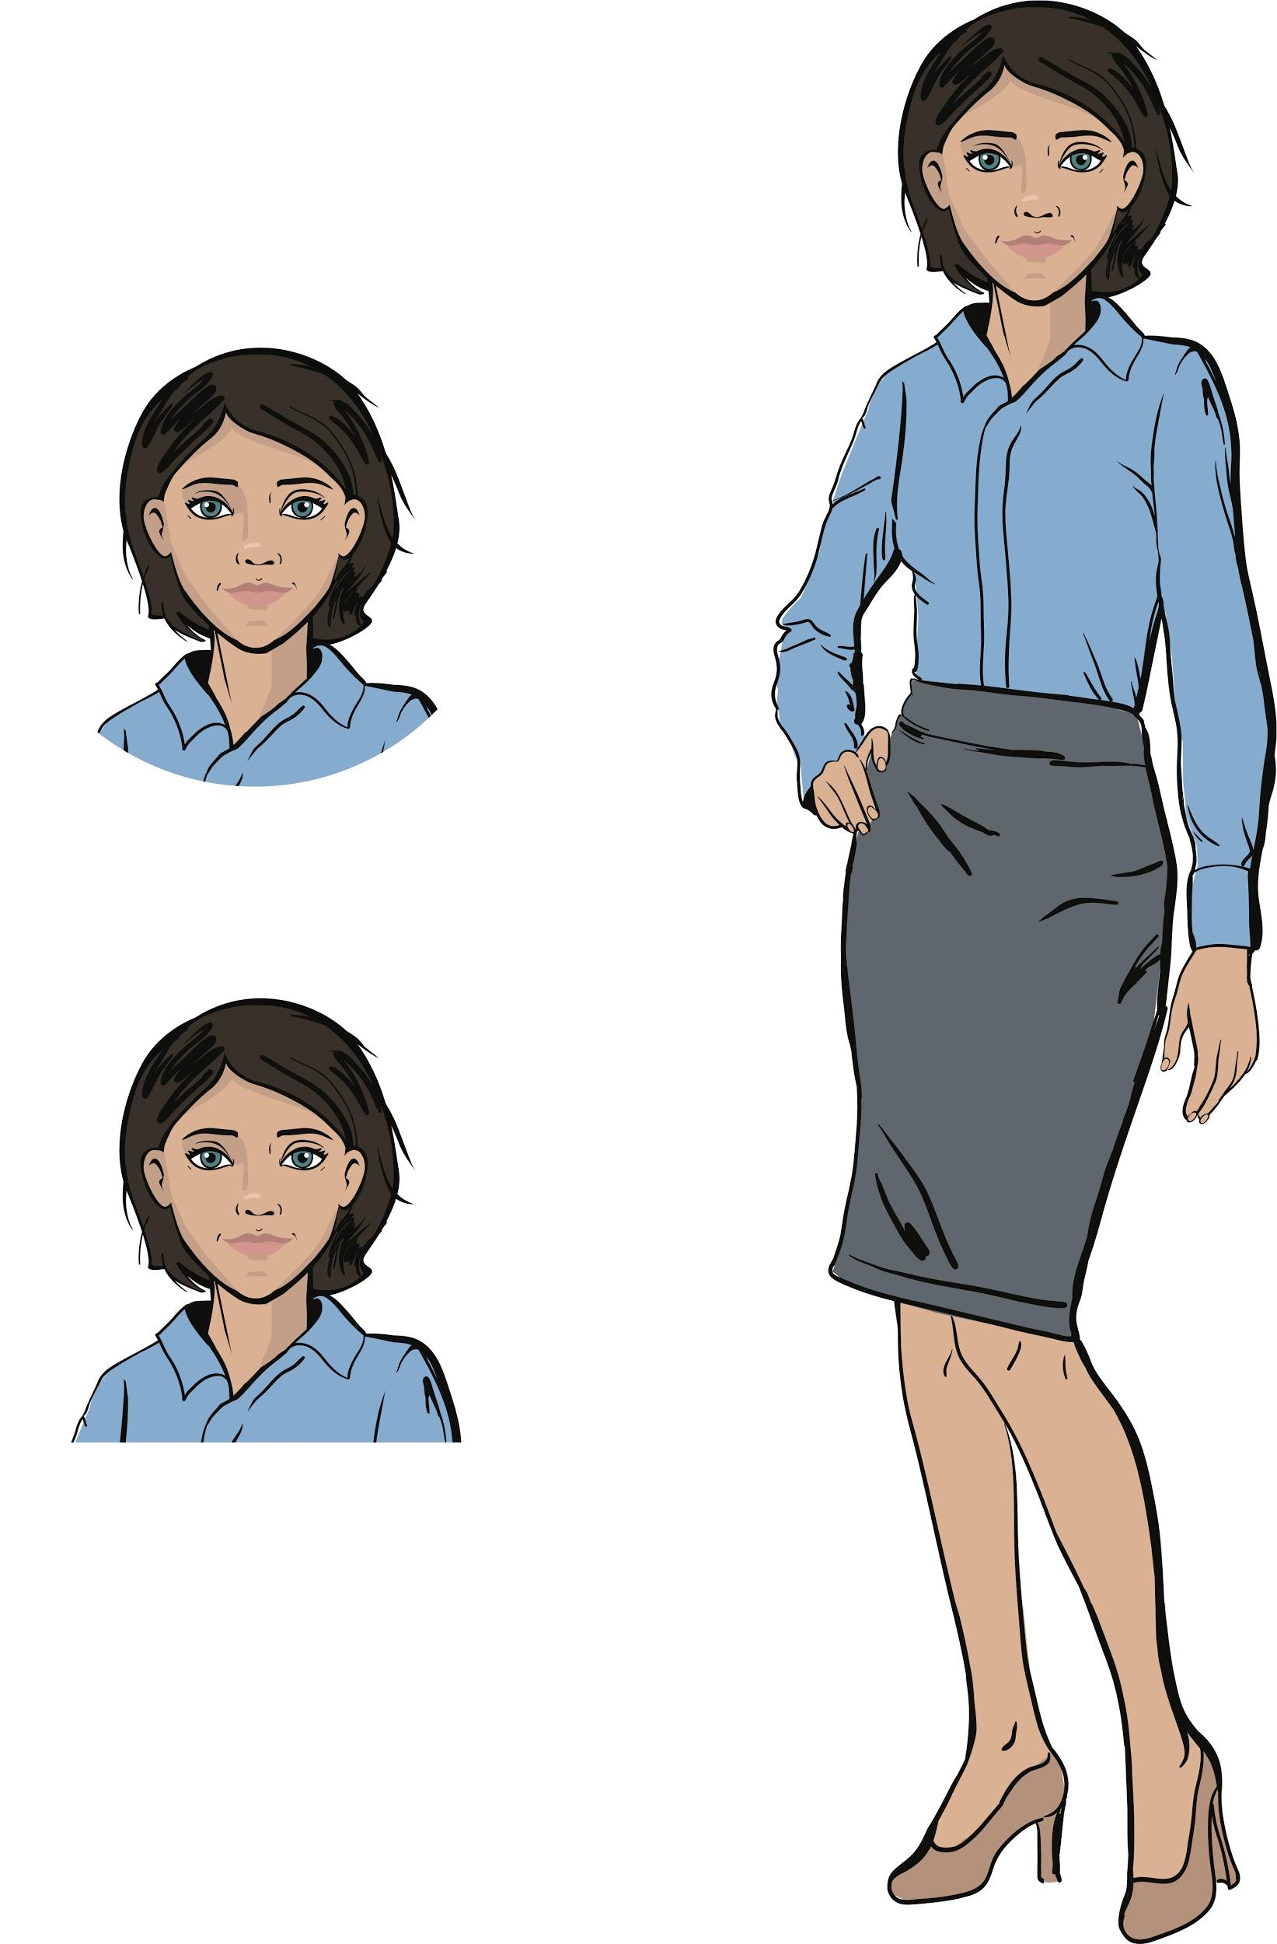

Finalizing work on the order
We've been working on a project for the "Citizen of the World" Cultural Center for several weeks.
The basic functionality is already programmed.
All that remains is to introduce a couple of interesting mechanics and prepare the product presentation.
Are you ready to continue working?
Discussion of work tasks
Emily, Project Manager

Slide 4
Let's consider the project mind map
Creating widgets
Positioning in layouts
Main layout display
Creating widgets
Positioning in layouts
Main layout display
Question form display
Answer form display
Memory Card
The basic tasks for this project have already been resolved
Storing questions
Event handling
Question and answers structure
Storing all the questions
Question display
"Answer" button click handling
Radio button click handling

Slide 5

Software development stages
The software development process is actually much broader.
Today, we will not only complete the project, but also test how it works and make a presentation for the customer.
Discussion of work tasks
What stages of work on a project (commercial product) do you know?

Slide 6
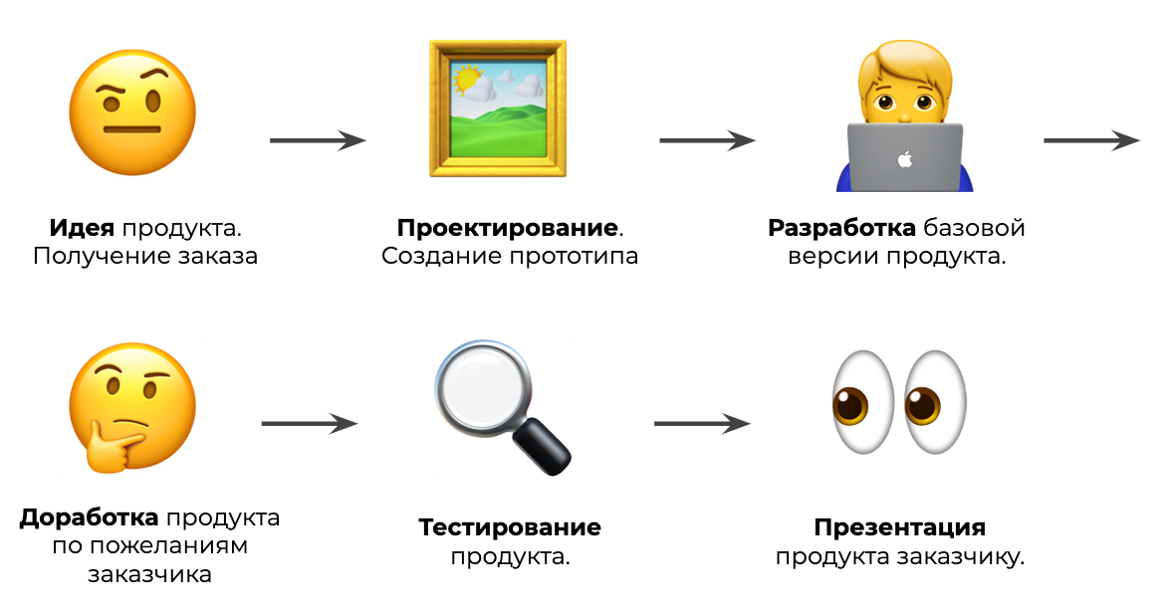
Software development stages
Product idea.
Receiving an order
Design
Prototyping
Prototyping Developing a basic version of the product.
Discussion of work tasks
Finalizing the product according to the client’s wishes
Product testing.
Presenting the product to the customer.

Slide 7
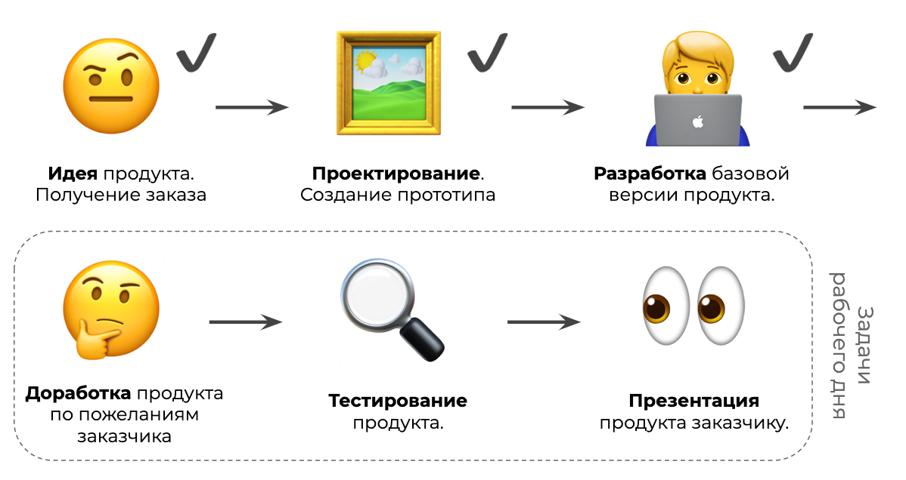
Software development stages
Product idea.
Receiving an order
Design
Prototyping
Prototyping Developing a basic version of the product.
Discussion of work tasks
Tasks for the work day
Finalizing the product according to the client’s wishes
Presenting the product to the customer.
Product testing.
Working day tasks

Slide 8
Software development stages
🤨
🖼️
🧑‍💻
Product idea.
Receiving an order
Design.
Prototyping
Developing a basic version of the product.
Discussion of work tasks
🤔
🔍
👀
Finalizing the product according to the customer's wishes
Product testing.
Presenting the product to the customer.

Slide 9
Software development
stages
🤨
✔️
🖼️
✔️
🧑‍💻
✔️
Product idea.
Receiving an order
Design.
Prototyping
Developing a basic version of the product.
Discussion of work tasks
🤔
🔍
👀
Tasks for the work day
Finalizing the product according to the customer's wishes
Product testing.
Presenting the product to the customer.

Slide 10
The goal of the working day is
to complete our work on the Memory Card Application and present it to the customer.
Today you will:
Discussion of work tasks
Finalize the app according to the customer's wishes.
Test how the app works.
Make a presentation of the project for the customer!

Slide 11

Module 2. Lesson 6. Memory Card Application. P. 4
Brainstorming:
Finalizing the App

Slide 12
The customer's wishes
Yesterday, I showed the first version of the product to the customer, and they asked us to add two mechanics:
Displaying the questions in a random order. The customer wants the questions to be chosen randomly from the list instead of always being asked in the same order.
Collecting answer statistics and displaying them to the console. The number of correct answers and the employee's rating are useful for assessment.
Let's start with displaying questions.
Brainstorming

Slide 13
Random order of questions
Task. Finalize the Memory Card Application. The program must ask questions, not in order (as they are in the list), but randomly.
Brainstorming
How do we modify the program?

Slide 14
Random order of questions
Task. Finalize the Memory Card Application. The program must ask questions, not in order (as they are in the list), but randomly.
next_question() is responsible for displaying the first and next questions:
The app window property window.cur_question is no longer needed.
Instead, we introduce the cur_question variable locally (in the function scope)
Brainstorming

Slide 15
Random order of questions
Task. Finalize the Memory Card Application. The program must ask questions, not in order (as they are in the list), but randomly.
next_question() is responsible for displaying the first and next questions:
The app window property window.cur_question is no longer needed.
Instead, we introduce the cur_question variable locally (in the function scope):
Brainstorming
A fragment of the function:
cur_question is the number of the current question.
It is a random number within the list.
cur_question = randint(0, len(questions_list) - 1)
q = questions_list[cur_question]

Slide 16
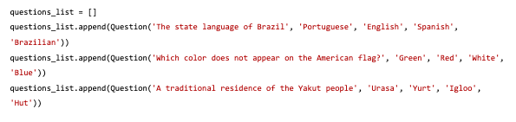
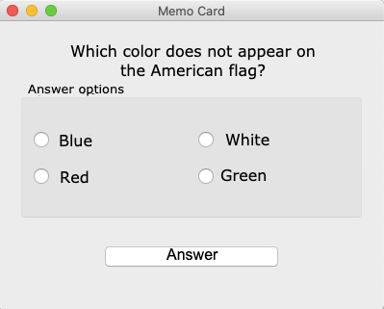
Changes in the program:
class Question():
Class description
App interface
Functions displaying a question
def next_question():
Brainstorming
Modified body with a random question number cur_question
Creating a window, running the app
Handling clicking on btn_OK with the click_OK function
Program appearance right after startup

Slide 17
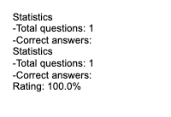
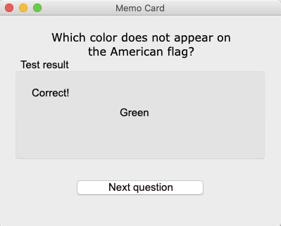
Statistics collection and rating calculation
Task. Add statistics and rating output to the console. Statistics means the current number of questions asked and correct answers given. Calculate the rating using the formula:
Number of correct answers
Rating =
100
Number of questions asked
Brainstorming
Statistics after a correct answer to one question

Slide 18
Statistics collection and rating calculation
Task. Add statistics and rating output to the console. Statistics means the current number of questions asked and correct answers given. Calculate the rating using the formula:
Number of correct answers
Rating =
100
Number of questions asked
Let's introduce two accumulators: one for all the questions (total) and one for correct answers (score).
To access them from different functions, let's make them window properties.
Brainstorming

Slide 19
Statistics collection and rating calculation
Task. Add statistics and rating output to the console. Statistics means the current number of questions asked and correct answers given. Calculate the rating using the formula:
Number of correct answers
Rating =
100
Number of questions asked
Let's introduce two accumulators: one for all the questions (total) and one for correct answers (score).
To access them from different functions, let's make them window properties:
Let's reset the accumulators when starting the program:
Brainstorming
btn_OK.clicked.connect(click_OK)
window.score = 0
window.total = 0
next_question()

Slide 20
Statistics collection and rating calculation
Task. Add statistics and rating output to the console. Statistics means the current number of questions asked and correct answers given. Calculate the rating using the formula:
Number of correct answers
Rating =
100
Number of questions asked
The window.total accumulator is incremented when a new question is displayed:
def next_question():
window.total += 1
Brainstorming
The window.score accumulator is incremented when a new question is displayed:
def check_answer():
if answers[0].isChecked():
show_correct('Correct!')
window.score += 1

Slide 21
Statistics collection and rating calculation
Task. Add statistics and rating output to the console. Statistics means the current number of questions asked and correct answers given. Calculate the rating using the formula:
Number of correct answers
Rating =
100
Number of questions asked
The window.total accumulator is incremented when a new question is displayed:
def next_question():
window.total += 1
Brainstorming
Statistics output when the value changes.
The window.score accumulator is incremented when a new question is displayed:
def check_answer():
if answers[0].isChecked():
show_correct('Correct!')
window.score += 1
Statistics and rating output when the value changes.

Slide 22
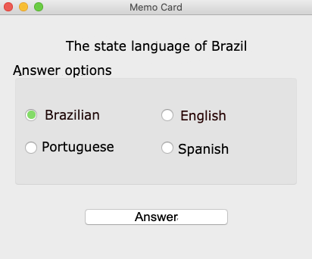
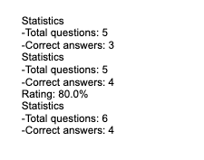
Changes in the program:
class Question():
Class description
App interface
def check_answer():
Modified body with window.score accumulator and statistics and ratings printing
def next_question():
Brainstorming
Modified body with window.total accumulator and statistics printing
Creating a window, running the app
Accumulators initialization, btn_OK click handling

Slide 23

Expected result:
At least three questions with answer options have been added to the app.
The app displays the questions in random order.
The app is calculating user statistics and ratings non-stop.
The results are output to the console.
Brainstorming

Slide 24

Module 2. Lesson 6. Memory Card Application. P. 4
Visual Studio Code:
Memory Card Application

Slide 25


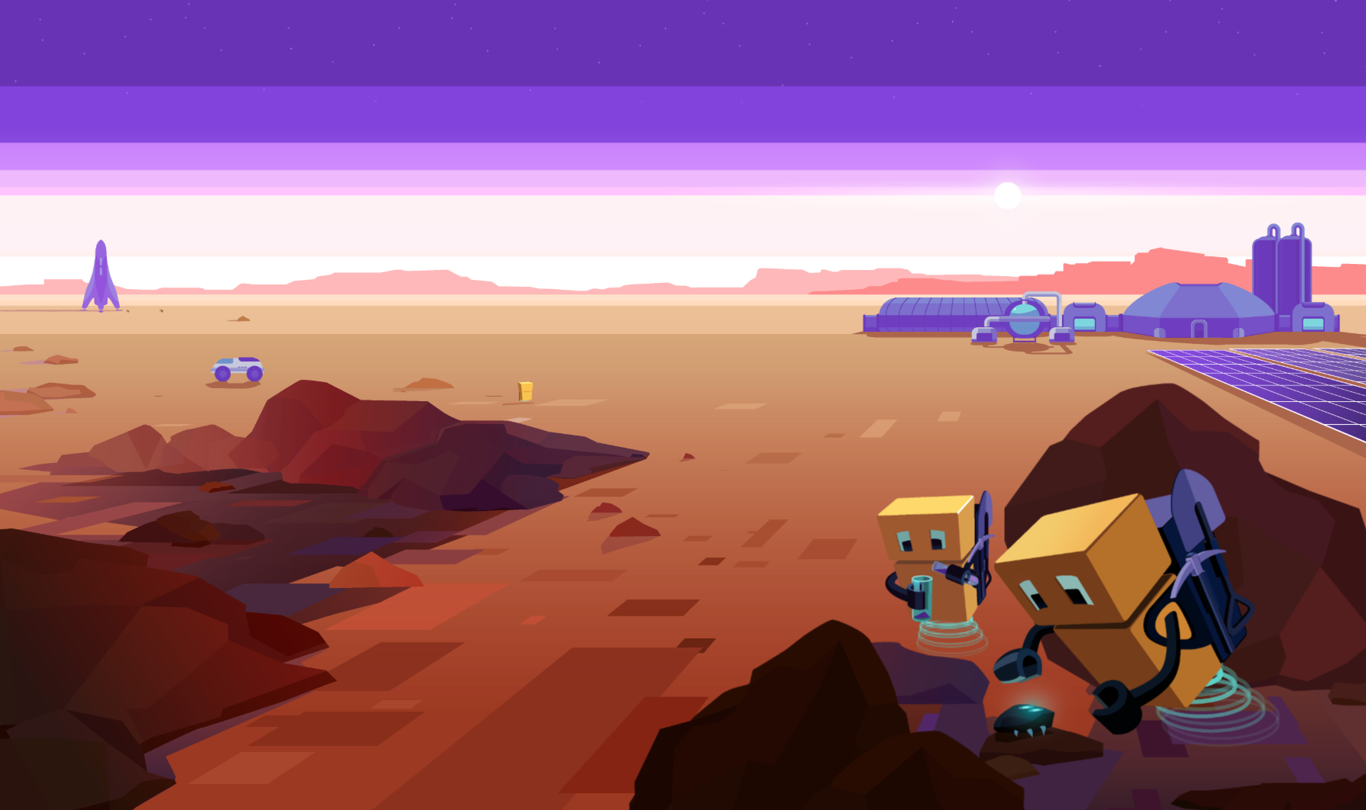

Complete the task in VS Code
“VSC. PyQt. Memory Card”
Visual Studio Code by Algorithmics
Creating the Application

Slide 26
Module 2. Lesson 6. Memory Card Application. P. 4
Brainstorming:
Finalizing the Project

Slide 27
Software development stages
🤨
✔️
🖼️
✔️
🧑‍💻
✔️
Product idea.
Receiving an order
Design.
Prototyping
Developing a basic version of the product
Brainstorming
✔️
🤔
🔍
👀
Finalizing the product as per the customer's wishes
Product testing
Presenting the product to the customer

Slide 28
Product testing
There are different approaches to testing. For our Memory Card project, testing will be as follows:
Stage Name | Essence
Preliminary stage | At least 10 questions on the subject given by the customer are added to the program.
Self-testing | The developer starts the app and interacts with it as a user: External attributes test (randomizing questions and answer options, displaying the correct answer) Functionality test (correct statistics calculation)
Third-party testing | The project is given to another specialist for testing. They check how the program works and provide feedback.
Brainstorming

Slide 29
Presenting the product
In addition to implementing a project, a good developer must also be able to present the result to the customer.
A report on the work done will be sent to the "Citizen of the World" Center via the Laboratory.
We will need to:
Arrange the results of our work visually.
Demonstrate important mechanics.
Demonstrate test results.
Brainstorming

Slide 30
Presenting the product
In addition to implementing a project, a good developer must also be able to present the result to the customer.
A report on the work done will be sent to the "Citizen of the World" Center via the Laboratory.
We will need to:
Arrange the work result visually.
Demonstrate important mechanics.
Demonstrate test results.
For a short and effective presentation you can use:
graphics editors
presentation apps
video editing
and any other tools!
Brainstorming

Slide 31
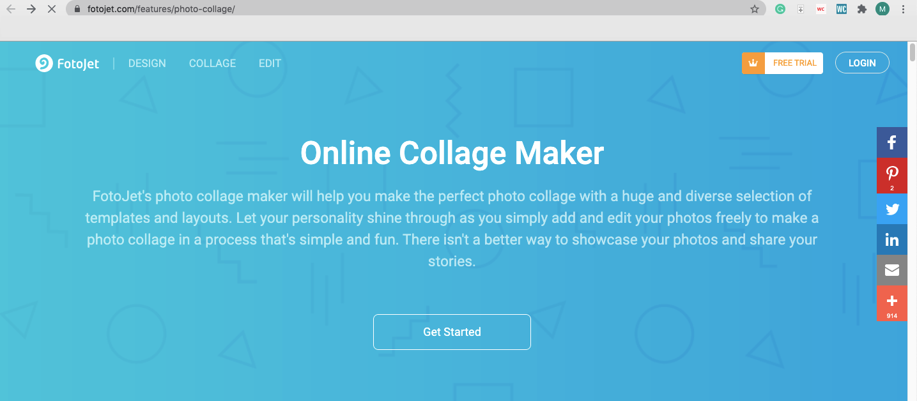
Presenting the product
One possible tool for presenting the work you have done:
Brainstorming

Slide 32
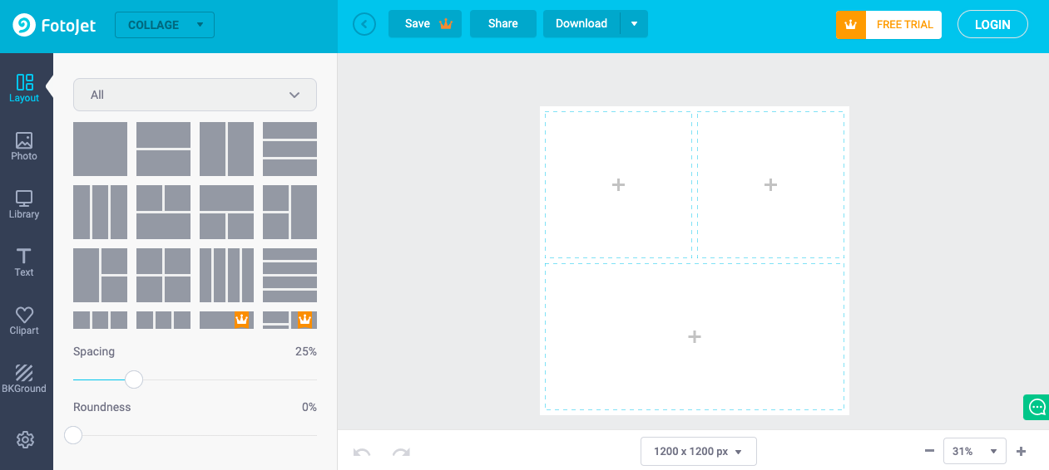
Presenting the product
The program interface and how it works can be presented in a collage.
Brainstorming

Slide 33
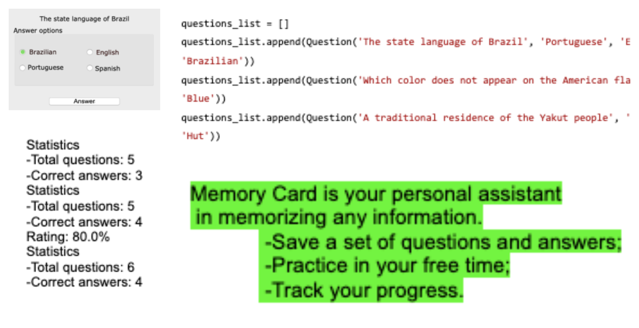
Presenting the product
The program interface and how it works can be presented in a collage.
Explain the purpose of the app.
Demonstrate the interface elements.
Show off the key mechanics.
Report the test results.
“Brainstorm”

Slide 34
Work plan:
Test the app, first independently, and then together with another developer.
Arrange the result of your work, download and publish a presentation in the Laboratory.
Study the presentations of your colleagues and leave feedback (comments under the publication).
Brainstorming

Slide 35
Module 2. Lesson 6. Memory Card Application. P. 4
Laboratory:
Testing and Presentation

Slide 36
Publish the result in the Laboratory
Share the result of your work with customers and colleagues in the Laboratory
Laboratory
Finalizing the Work

Slide 37

Module 2. Lesson 6. Memory Card Application. P. 4
Wrapping up the work day

Slide 38

Dear developers, share the results of your work!
Introduce yourselves. Tell us what project you have been working on. What target audience is it designed for?
Show off the result of your work. Has the product been tested? What limitations does it have?
What interesting mechanics does the project have? What is its competitive advantage?
Wrapping up
the work way

Slide 39
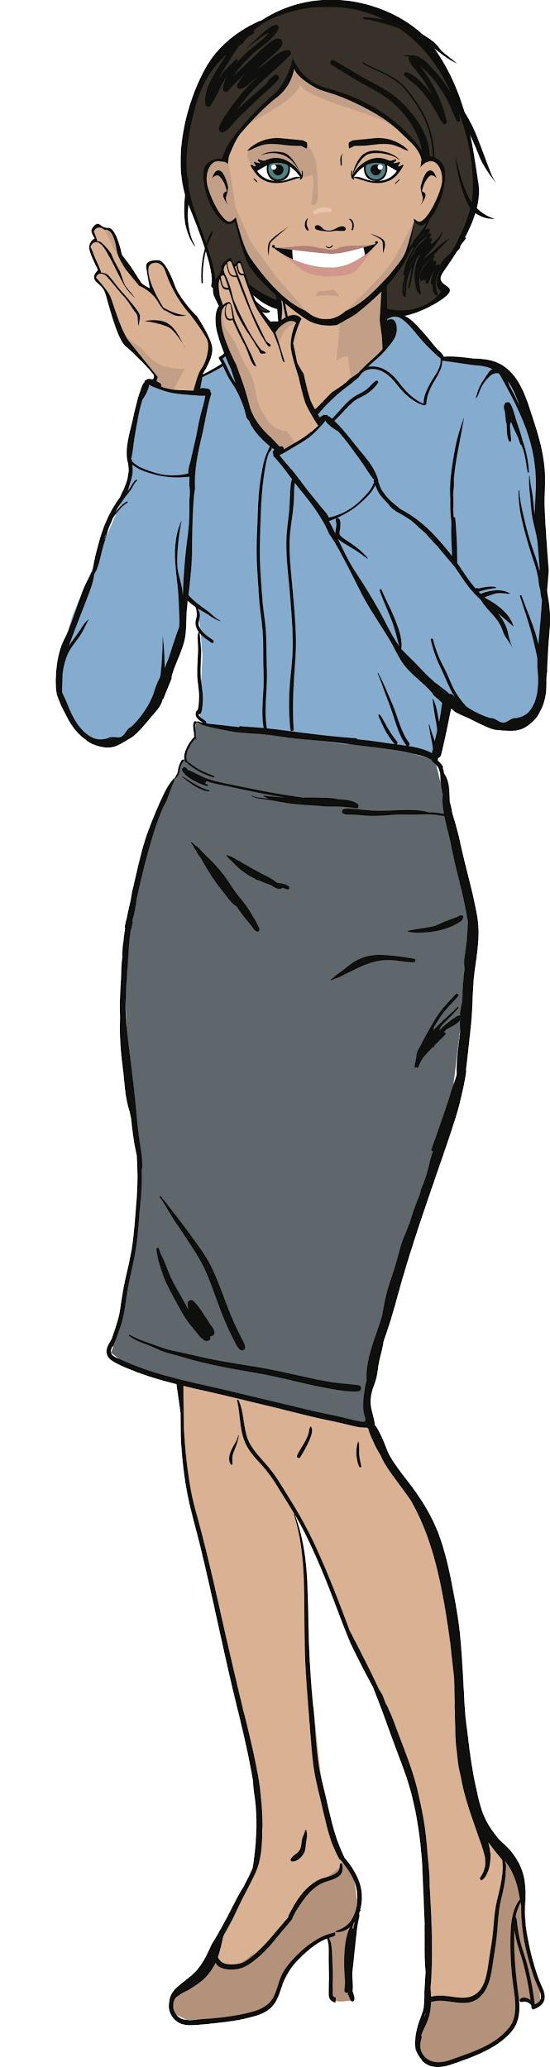
Congratulations on delivering a big commercial order!
Answer these questions with your colleagues:
What was the best thing you managed to do?
What didn't work out the way you wanted?
What should you do next time
to ensure success?
Wrapping up
the work way

